Slide 1

HANDWRITTEN DIGIT RECOGNITION

Slide 2
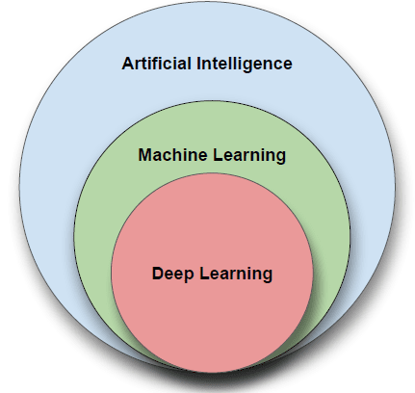
INTRODUCTION
Artificial intelligence (AI) is the ability of machines to replicate or enhance human intellect, such as reasoning and learning from experience. Artificial intelligence has been used in computer programs for years, but it is now applied to many other products and services.
Different fields of AI to clear common misconceptions
It’s essential to know that AI is not a single field but a combination of various fields. Artificial Intelligence (AI) is the general term for being able to make computers do things that require intelligence if done by humans. AI can be broken down into two major fields, Machine Learning (ML) and Neural Networks (NN) in Deep Learning.

Slide 3
PROBLEM DEFINITION
Handwritten character recognition is one of the practically important issues in pattern recognition applications. The applications of digit recognition include in postal mail sorting, bank check processing, form data entry, etc. The main problem lies within the ability on developing an efficient algorithm that can recognize hand written digits, which is submitted by users by the way of a scanner, tablet, and other digital devices. This project presents an approach to off-line handwritten digit recognition based on different machine learning techniques. The main objective of this project is to ensure the effectiveness and reliability of the approached recognition of handwritten digits.

Slide 4
EXISTING SYSTEM
Various algorithms used for implementing handwritten digit recognition systems consist of Proximal Support Vector Machine (PSVM), Multilayer Perceptron, Support Vector Machine (SVM), Random Forest, Bayes Net, Naive Bayes, J48, Random Tree. According to previous research work, accuracies provided by these algorithms are of the order of: ● Proximal SVM - 98% ● Multilayer Perceptron - 90% ● SVM - 87% ● Random Forest - 85% ● Bayes Net - 84% ● Naive Bayes - 81% ● J48 - 79% ● Random Tree - 75% .

Slide 5
PROPOSED SYSTEM
In this project, we are going to implement a handwritten digit recognition app using the MNIST dataset. We will be using a special type of deep neural network that is Convolutional Neural Network (CNN). In the end, we are going to build a GUI in which you can draw the digit and recognize it straight away, and also accuracy of digit recognized is displayed in percentage. The digit can be handwritten using cursor/pointer on the GUI and the digit entered can be predicted

Slide 6
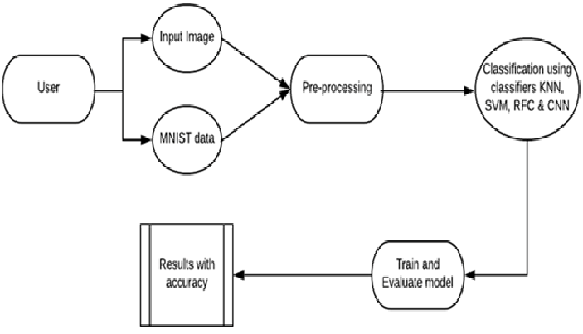
DESIGN
ACTIVITY DIAGRAM

Slide 7
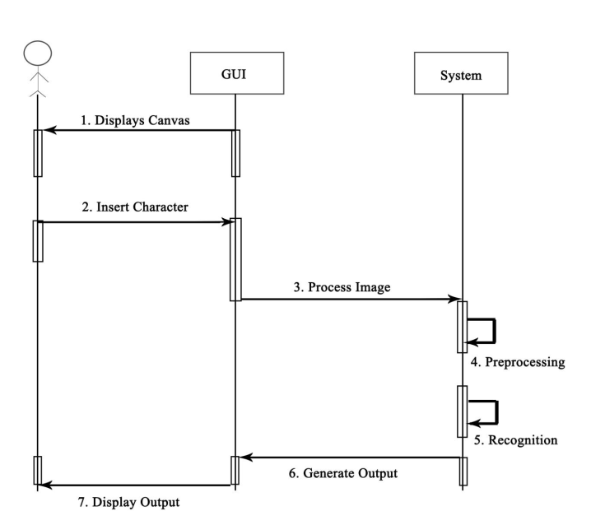
DATA FLOW DIAGRAM

Slide 8
The project is designed completely using python 3.10 using various python libraries, GUI (Graphical User Interface), CNN (Convolutional Neural Network) and MNIST dataset.
To build the handwritten Digit Recognition the following design and steps have been implemented.
Import the Libraries and Dataset
Pre-process the data.
Create the Model.
Training the Model.
Evaluating the Model
Creating the Model

Slide 9
REQUIREMENTS
SOFTWARE REQUIREMENTS.
Windows 7 or higher.
Python 2.9 or higher (currently using 3.10)
Terminal.
HARDWARE REQUIREMENTS.
A Laptop or Desktop.
Memory -ROM 10 GB or more.
-RAM 2 GB or more.

Slide 10
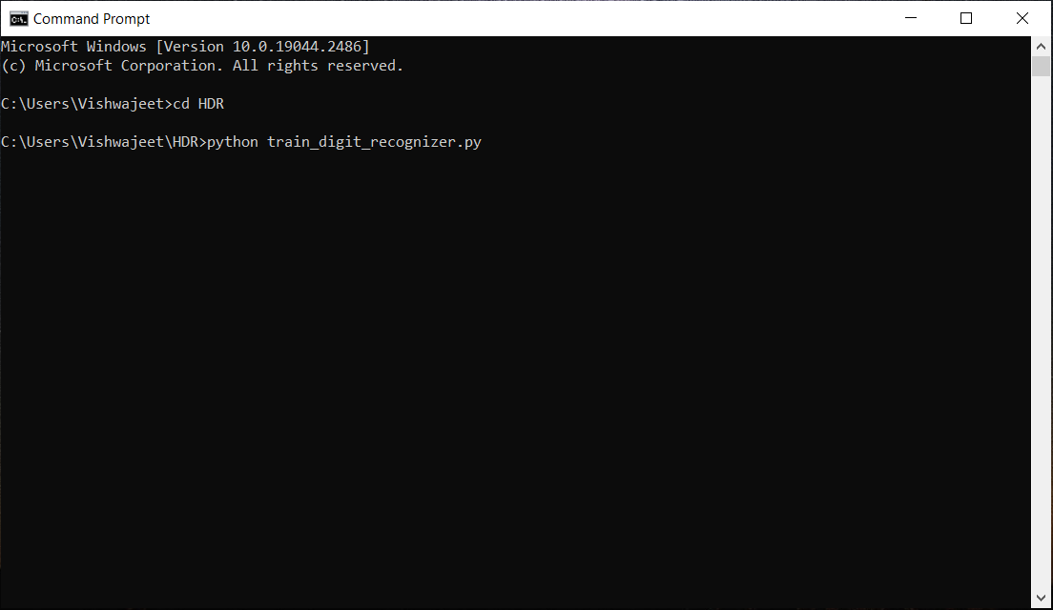

SCREENSHOTS
TERMINAL COMMANDS
Command to Train the model.
Command to run the GUI.

Slide 11
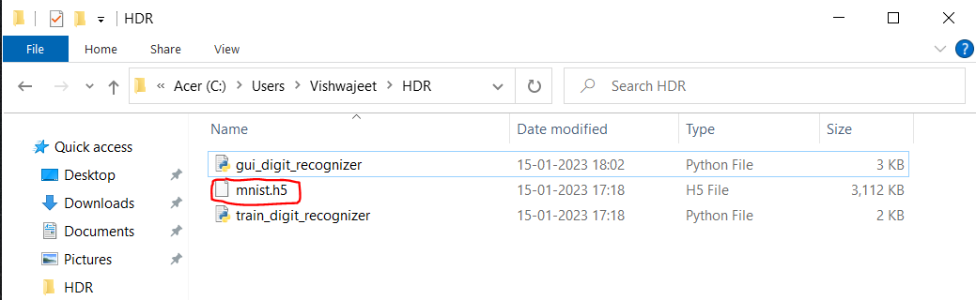
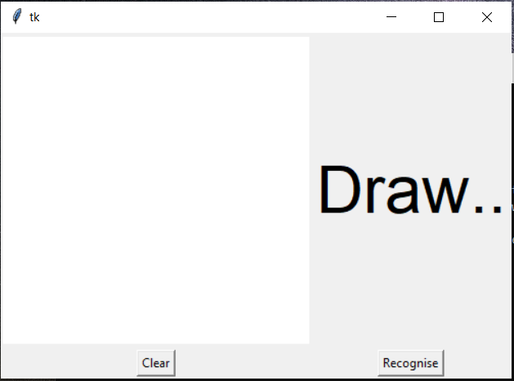
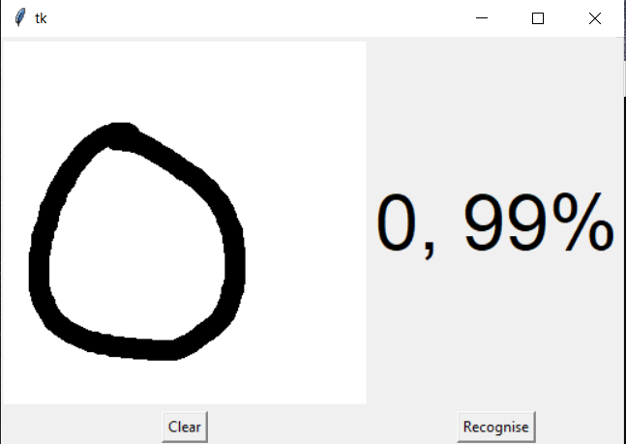
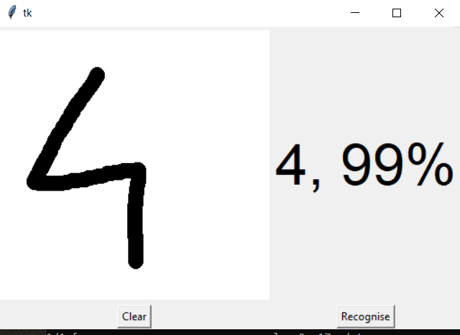
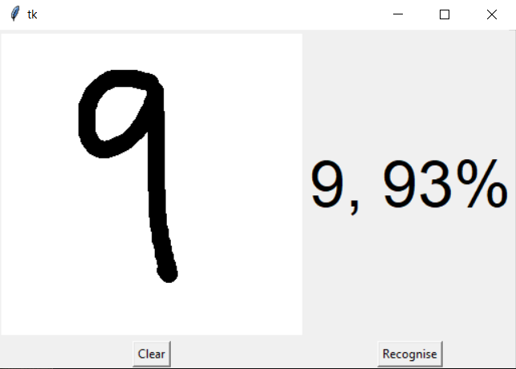
OUTPUT
Running the gui_digit_recognizer python produces the GUI canvas to draw digits on.
The Training Model Outputs ‘mnist.h5’ file.
Digit Recognition Output.

Slide 12
FUTURE SCOPE/ENHANCEMENT
The current project is built using python and the concept of deep learning and CNN. The only mode of input is mouse via GUI. And the right now only digits are recognized
The project has scope to enhance on all fronts that is it can be developed to use various other neural networks and tools to not only use the GUI but through various mediums to recognize the digits.
As we are talking about enhancement the software can be developed to recognize not only handwritten digits but texts and stings and symbols.
The proposed system takes 28x28 pixel sized images as input. The same system with further modifications and improvements in the dataset and the model can be used to build Handwritten Character Recognition System which recognizes human handwritten characters and predicts the output.
The recognition system has huge scope in tasks such as Postal Mail Sorting, Bank Cheque Processing, Form Data Entry, etc.

Slide 13
CONCLUSION
Our project HANDWRITTEN DIGIT RECOGNITION deals with identifying the digits. The main purpose of this project is to build an automatic handwritten digit recognition method for the recognition of handwritten digit strings. In this project, CNN (Convolutional Neural Networks) architecture is used to achieve high performance on the digit string recognition problem.
The GUI predicts the digit with accuracy percentage but the software doesn’t have the option to show that the digit as unrecognizable instead it shows the nearest resembling digit. The option to build that was considered but due the complex nature of the code it was considered beyond scope which was recognize the handwritten digits.

